Slide 1
Project Alvarium
Enabling Data Confidence Fabrics to
Scale Trust Across Heterogeneous Systems
October 29, 2019

Slide 2
Project Alvarium at a glance
New LF project forming to focus on system-level trust and data confidence
Differentiated in its comprehensive view and in delivering data to applications with measurable confidence
  Unifying, not reinventing trust insertion technologies
  Relevant to all markets and solution stacks
Seeded by Dell Technologies code
Project Mission:
Create the framework and open APIs that bind together existing open source and commercial value-add for trust insertion, develop confidence score algorithms
Collaborate with other LF projects and industry efforts (OSS, SDO) to unify existing and emerging trust insertion technologies and refine scoring algorithms

Slide 3
What is a Data Confidence Fabric (DCF), or “trust fabric”?
A Data Confidence Fabric (DCF), or more generally-speaking trust fabric, is a virtual overlay that aids in the delivery of data from devices to applications with measurable trust characteristics.
A DCF is a loosely-coupled collection of various trust insertion technologies, bound together with an open framework
  Example technologies include tools for silicon-based Root of Trust (RoT), open authentication and data ingestion APIs, metadata handling, immutable storage and blockchain/ledger
The Alvarium framework features open APIs and integrated algorithms to generate confidence scores for data based on the trust insertion technologies used and overall context
There is no single DCF, rather each entity/organization can build their own fabric with preferred technologies using the Alvarium framework
  A trust fabric built with widely trusted ingredients will naturally produce the highest data confidence scores
  Confidence scores normalize across systems of systems as data flows through intersecting trust fabrics
Key differentiation from other efforts focused on security, privacy and trust:
  Holistic, system-level focus
  Confidence scores to enable organizations to act with measured risk based on policy appropriate for the use case / context, working across heterogenous systems of systems

Slide 4
Why we need to collaborate on a global trust fabric
Pervasive sharing and monetization of data, resources and services across heterogenous systems of systems spanning public and private boundaries
  Can also include trusted sharing/exchange of data sets for training AI model
  The common “zero trust” model isn’t scalable, access policy needs to be attached to trustworthy data
Consolidating workloads on common infrastructure in a trusted fashion
  Enable sharing of data/services based on policy while protecting privacy and IP
  Address common debates on data ownership
Meeting compliance requirements (e.g. GDPR) at scale
  Enables organizations to trigger deletion of distributed data in place when a user requests to revokes privacy consent

Slide 5
Example end-to-end trust insertion points
1. HW root of trust signatures on device data
2. Strong
N-S-E-W
AuthN/AuthZ
3. Open data ingestion software
4. Trusted Execution Environments
5 Metadata/policy attachment
(e.g. data capture environment, provenance, confidence score, policies for sharing/monetization)
6. Secure, immutable scale-out storage
7. Registration of trusted assets in a multi-cloud distributed ledger
While trust insertion can be performed at any point in the continuum, ideally trust insertion begins as close as possible to the data source at the device edge.
DEVICE EDGE
CLOUD

Slide 6
Example OSS trust insertion technologies
TPM
ARM PSA-RoT), TrustZone
Linaro Trusted Substrate
Intel/Arm SDO
VMware Lightwave
Keycloak
EdgeX Foundry
Fledge
Eclipse Kura
Intel SGX
Microsoft Open Enclave SDK
Red Hat Enarx
(Hosted by the Confidential Computing Consortium)
Siemens Coaty.io
Tibco Flogo
CNCF Open Policy Engine
IPFS
Hyperledger
IOTA
Ethereum
1. HW root of trust signatures on device data
2. Strong
N-S-E-W
AuthN/AuthZ
3. Open data ingestion software
4. Trusted Execution Environments
5.Metadata/policy attachment
(e.g. data capture environment, provenance, confidence score, policies for sharing/monetization)
6. Secure, immutable scale-out storage
7. Registration of trusted assets in a multi-cloud distributed ledger
Additional trust insertion technologies include Hypervisors, OS, Management and Orchestration tools, etc.

Slide 7






Initial DCF prototype
Dell Technologies’ initial Data Confidence Fabric (DCF) prototype (completed in August 2019) demonstrated a trust fabric comprised of a mix of open source and commercial technologies
Prototype was deployed entirely on one edge system to locate policy insertion for data monetization/compliance as close as possible to the data source
  Alvarium framework unifies the various loosely-coupled trust insertion elements
  Solution could just as well be deployed in a distributed fashion
Next steps in prototyping – demonstrating technology swapability, for example exchanging Project Concord ledger for Hyperledger or IOTA
Dell will contribute the Alvarium framework code to seed the project
VMware Pulse IoT Center SaaS
VMware Project Concord Ledger
VMware
Lightwave Server
Alvarium
Framework
DATA SIMULATOR

Slide 8
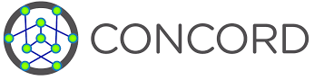
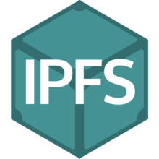

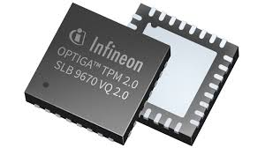
Example Confidence Scoring
“Perfect 10”
Scoring creates a weighted confidence depending on trust insertion technologies implemented in a given trust fabric
Dell’s initial DCF prototype leveraged a simple linear scale for simplicity
Scoring algorithms will require industry collaboration to develop
  Initially via OSS but may require some standards work
  Likely to make sense for weighted scoring, some factors that zero out confidence
+2
Ledger Registration
High
Trust
+2
Secure Immutable Storage
+2
Medium
Trust
Gateway AuthZ/AuthN
+2
Provenance
Metadata
+2
Low
Trust
Device Signatures
0
Unknown
Trust
(No DCF)

Slide 9
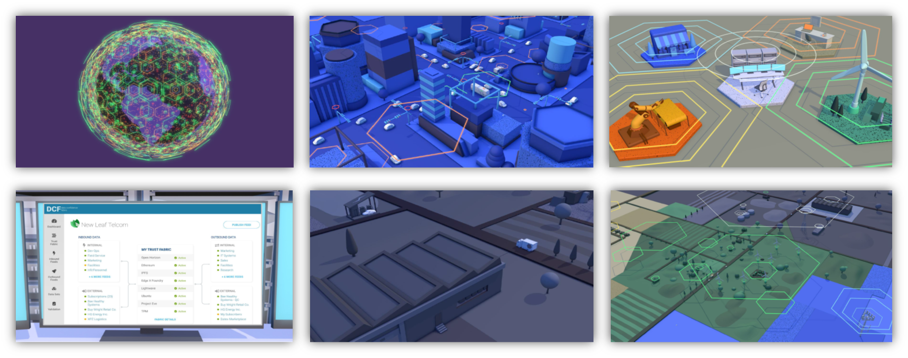
Dell Technologies project contribution
Alvarium framework seed code and basic documentation
Project branding and vision video explaining impact across markets

Slide 10
Why ultimately form under LF Edge?
All data is created at the edge
Highest confidence achieved with trust insertion technologies applied as close to data source as possible
Project Alvarium will make ties to other key industry efforts, both inside of LF Edge, within the broader Linux Foundation (e.g. Confidential Computing Consortium, CNCF, LF Networking) and externally (e.g. IOTA, Linaro, TIoTA)
  Unifying, not reinventing trust insertion technologies

Slide 11
Current Status & Next Steps
Continue onboarding collaborators, including links to other key industry projects, both within and external to the LF
Dell Technologies seed code to be donated in early 2020

Slide 12
THANK YOU!

Slide 13
Key concept: interlocking circles of trust
DCFs aid in trust relationships between interlocking circles of trust, both internal and external to a given entity/organization
As data flows between the boundary condition of any given set of intersecting trust fabrics the confidence score normalizes based on overall context
Stakeholders internal to my organization
Stakeholders external to my organization
Supplier A
LoB
OT
IT
DC
PCs
Net-work
Quality
Safety
Prod-uction
Service Provider
Supplier B

Slide 14
Key concept: inputs and outputs to a given DCF
Primary Internal DCF
Internal Data Inputs
Internal Data Outputs
External Data Inputs
External Data Outputs
Satellite “connective” DCF implementations

